Slide 1
Linport: as a Standard for Interoperability Between Translation Systems
Tyler Snow
Brigham Young University
Translation Research Group

Slide 2
Abstract:
Abstract:
  There are many evolving technology standards in the translation/localization industry, such as XLIFF and the Internationalization Tag Set (ITS).
  The Linport project aims to define a standard container format for translation projects and tasks within projects.
  Linport, XLIFF, and ITS are complementary
  This presentation presents the need for a container standard in addition to XLIFF and ITS and describes the status and likely future of Linport

Slide 3
Container Formats
Being able to send a message does not guarantee communication. Language is a barrier
A similar communication breakdown can occur between translation systems
Many translation file formats!
Good technological communication saves time and money
Containers as a possible solution?

Slide 4
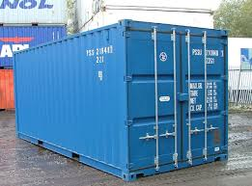
Shipping containers

Slide 5
“Shipping” in the translation industry
Similar to the previous example: Translation projects between different TEnT tools cannot be easily opened in another
Best case scenario: similar file types without association
Worst case scenario: different file types

Slide 6
Linport
Language Interoperability Portfolio
An open, comprehensive, interoperable container solution for all translation processes
Currently under development
Carries the details and various files pertaining to each task of a translation project.
Can contain a variety of proprietary formats

Slide 7
How does Linport contain files?
Standardized directory structure format.
Portinfo
  metadata
Payload
  EN
    Docplus (unique name equal to those in other groupLangs)
      support
      Doc (one translation file)
http://dragoman.org/linport/ldm.txt

Slide 8
STS
Structured Translation Specifications
21 translation parameters for translation project definition
Considers: Source, Target, Environment, Stakeholder Relationships
Defines metadata (localization) at the project and task level in Linport
http://ttt.org/specs

Slide 9
History of Linport
2011 LISA –Container format and STS
2011 EC DGT -MED
2010- IN! TIPP
Other groups soon joined in.

Slide 10
Relationship to other formats
Other specifications address part of the industry need.
Linport works at a different level of abstraction than most specifications mainly at the project data level
Enhances capability of already capable file formats
Organizes these formats to promote efficiency
Two of these formats are:
  XLIFF
  ITS

Slide 11
XLIFF
Very important localization related standard.
Used in storing, translating and reexporting content
Any two tools with XLIFF import/export can easily transfer translation data
Linport adds:
  Ability to package multiple XLIFF files as a project
  Include related support files to those XLIFF files
  Metadata including STS is added and passed along the translation process with the XLIFF file
  All this will maintaining the relationship information between XLIFF and support files across TEnT systems

Slide 12
Continued
XLIFF helps Linport! Novice Linport users might pass along PDFs as source texts
When XLIFF is used as the source text, Linport interoperability is enhanced at the task level
Thus it is hoped that Linport users will incorporate XLIFF at the very heart of their portfolios
Perhaps a “strict” Linport version will require XLIFF.
Taken together these points demonstrate that an ideal ecosystem would support both XLIFF and Linport, with both formats handling their respective strengths in tandem to help deliver process resources and automation (Linport) and low-level content interoperability (XLIFF)

Slide 13
ITS
Simplest example of ITS = the translate category
Localization notes, which provide guidance for how content should be treated in localization processes
The ability to mark and identify terminology
The ability to identify text directionality in formats that do not natively support it
Information about the language of text.
A mechanism to specify whether XML elements within text should interrupt text flow or be seen as part of the surrounding text

Slide 14
Continued
Information on the domain (subject field) of text
The results of automated text analysis processes (such as named entity extraction)
The ability to tag text (locale filter) for translation into specific locales (or to exclude it from translation for specific locales)
A mechanism to identify the provenance (source) of text, e.g., to state that particular content was translated with a particular system
A mechanism to point to external resources that contain the translatable text associated with a particular piece of content, such as a graphic, that cannot be translated directly

Slide 15
Continued
The ability to indicate that particular elements in a file format should contain the translation of particular other elements (target pointer)
A mechanism to add ID values to content that lacks them to support translation requirements
Indications as whether or not to preserve spaces in content
A set of metadata on localization quality issues and localization quality ratings

Slide 16
Continued
Information on the internal confidence of machine translation systems (MT confidence) that can be used to flag content for further attention
A mechanism to specify the allowed characters in a given piece of content (e.g., to state that a translation should not allow certain forbidden characters)
A way to indicate the maximum storage size for content, such as database entries, that must conform to size limitations

Slide 17
Linport and ITS
This List indicates some overlap between Linport and ITS functionality
The Difference is: abstraction
Once again they work together
Example: Linport might specify that the domain of an entire project is “legal” but ITS 2.0 can specify that a short section within a document in fact belongs to another domain: A company report needs to be translated BUT (e.g., there is a lengthy quotation from a company’s earnings report [domain = financial] embedded in a legal brief). That the company does not wish to be in the final translation

Slide 18
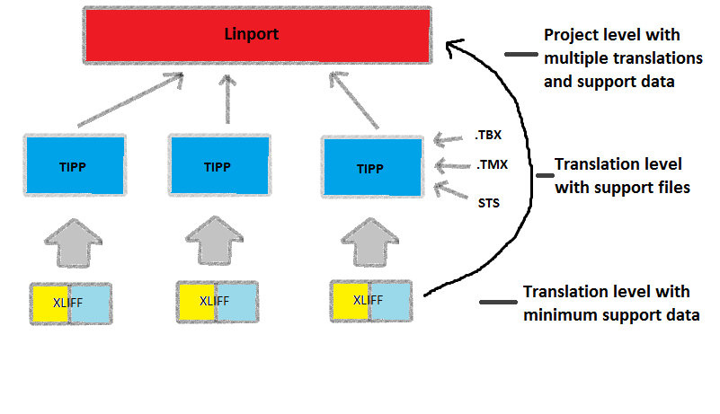
Ideal scenario
ITS
ITS
ITS

Slide 19
Linport split tool
http://split.linport.org

Slide 20
Quality Assessment Metrics
QTLP: (see http://www.qt21.eu/launchpad/)
an emerging translation quality assessment metric format that is customizable for different projects or documents.
QTLP or any other metric format can be contained in a Linport portfolio.
STS and QTLP recognize that translation quality is not a one size fits all proposition.
Translation parameters and quality measurements must be adapted to meet particular needs.

Slide 21
Linport, QTLP, and STS
Because all of these are included in Linport and passed along the translation chain, it helps to:
Set project expectations
Provide relevant ways of ensuring that expectations are met

Slide 22
Advantages of Linport
Ease of Implementation -Time
It is free! –Money (at least for now)

Slide 23
Current and future development
Portfolio data model needs to be refined and formalized with a schema and validation system
Submitted to a standards organization
Online portfolio builder
Splitter
Merger

Slide 24
How to get involved
Join the Linport community to participate in monthly conference calls and view ongoing progress reports and website posts at:
http://www.linport.org
as well as the GALA Linport community group at:
http://gala-global.org
Project data!!!!! Send to:
tylerasnow@gmail.com or
akmtrg@byu.edu

Slide 25
continued
Contribute testing apps developed for Linport
Develop your own Linport applications
Introduce Linport into your company’s translation workflow as an early adopter

Slide 26
The Linport community is open and thankful for any support you and your company are willing to provide
Thank you!
Slides and full paper will be available at http://www.linport.org

Slide 27
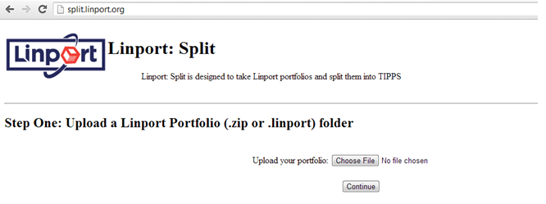

Slide 28
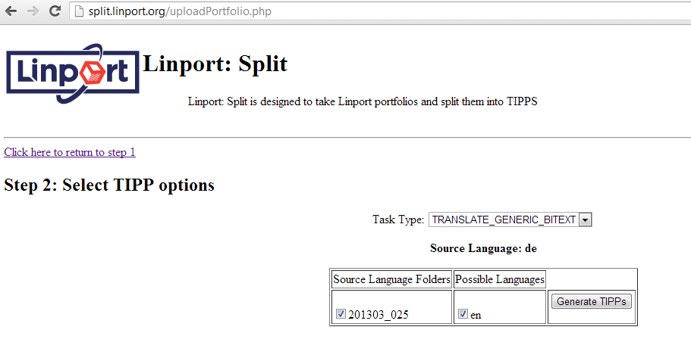

Slide 29
